Slide 1

Software Engineering (2304CS304)
Lab 2 UML Diagram
Prof. Mayur Padia
Computer Engineering Department
mayur.padia@darshan.ac.in
+91-9723232741

Slide 2
Use Case Diagram
A use case diagram is a representation of a user's interaction with the system.
This interaction shows the relationship between the user and the different use cases in which the user is involved.
The purpose of the use case diagrams is simply to provide a high-level view of the system and convey the requirements in layman's terms for the stakeholders.

Slide 3

Components of Use Case diagram
System boundary
Use case
Represent the scope of the system
Use cases of the system are placed inside the system boundary
Actors who interact with the system are placed outside the system
A use case represents a user goal / piece of functionality that can be achieved by accessing the system or software application.
Use
Cases
Actor
Association
An actor is an entity that interacts directly with the system but that is not part of system
Actor may be people, computer hardware, other systems, etc.
An actor and use case can be associated to indicate that the actor participates in that use case

Slide 4
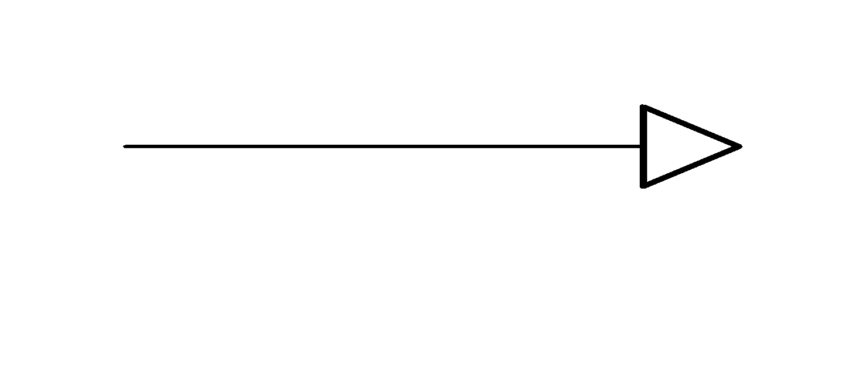
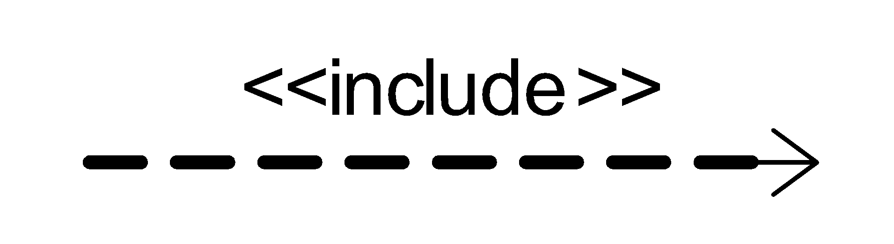
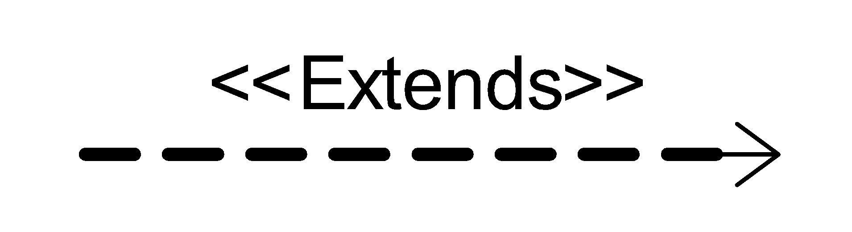
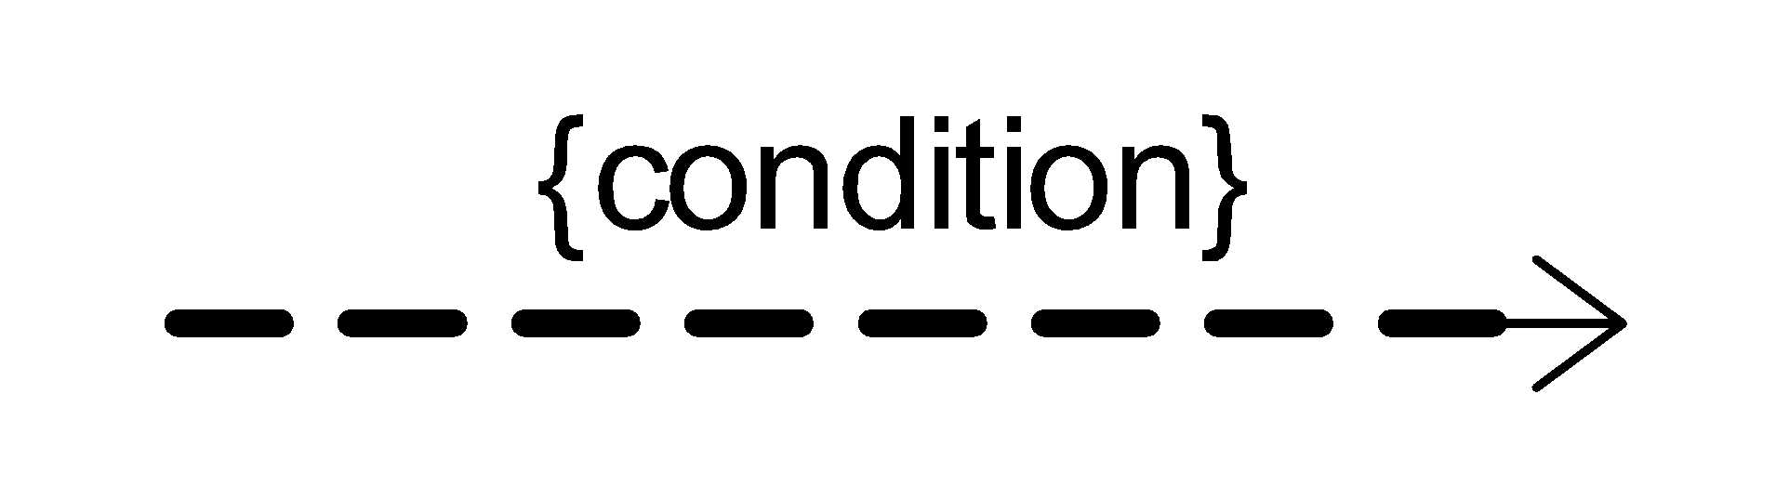
Components of Use Case diagram Cont.
Generalization
Include
A generalization relationship is used to represent the inheritance relationship between model elements of the same type
The use case is mandatory and part of the base use case.
It is represented by a dashed arrow in the direction of the included use case with the notation
Extend
Constraint
The use case is optional and comes after the base use case.
It is represented by a dashed arrow in the direction of the base use case with the notation
Show condition exists between actors and activity

Slide 5
Example of Extends and Include
Includes
Login
In e-commerce application that provides customers with the option of checking the status of their orders. For checking the status of their order user should be login.
This behavior is modeled with a base use case called CheckOrderStatus that has an inclusion use case called LogIn.
<<include>>
CheckOrder Status
Extends
pay for item
In e-commerce site, When paying for an item, you may choose to pay on delivery, pay using PayPal, or pay by card.
These are all alternatives to the "pay for item" use case. I may choose any of these options depending on my preference.
<<extend>>
<<extend>>
pay by card
pay on delivery

Slide 6
Guideline for constructing use case diagram
Determine the system boundary.
Ensure that actors are focused, each actor should have a single, coherent purpose. If a real world object contains multiple purpose, capture them with separate actors
Each use case must provide value of users
Relate use cases and actors

Slide 7
Library Management System(LMS) formal Requirement
A Library Management System is a software built to handle the primary housekeeping functions of a library.
In library management systems to manage asset collections as well as relationships with their members.
Library management systems help libraries keep track of the books and their checkouts, as well as members’ subscriptions and profiles.
Library management systems also involve maintaining the database for entering new articles and recording articles that have been borrowed with their respective due dates.

Slide 8
Identify the Functionality & Stakeholders for LMS
Functionality
Stakeholders
Register User
Add Article
Update Article
Delete Article
Inquiry Members
Inquiry Issuance
Check out Article
Check in Article
Reserve Article
Set user Permission
Search Article
Check Account
Prepare Library Database
Librarian
Member
Guest

Slide 9
Relationship Between Functionality & Stakeholders
Register user
Add Article
Update Article
Delete Article
Inquiry Members
Inquiry Issuance
Check out Article
Check in Article
Set user Permission
Request for registration
Guest
Librarian
Reserve Article
Search Article
Check Account
Member

Slide 10
Use Case Diagram Library Management
Library Management System
1. Login
10. Request registration
2. Register user
.3. Manage member permission
Guest
4. Add Article
11. Check account
5. Delete Article
13.Search by title
6. Inquiry article
<<extend>>
Member
7. Inquiry member
12. Search article
Librarian
8. Check in articles
<<extend>>
9. Check out articles
14 Search by publication

Slide 11
Use cases & Usage Scenarios
A collection of user scenarios that describe the thread of usage of a system
Each scenario is described from the point-of-view of an “actor”
An actor is a person or device that interacts with the software
Each scenario answers the following questions
Who is the primary actor, the secondary actor (s)?
What are the actor’s goals?
What preconditions should exist before the story begins?
What main tasks or functions are performed by the actor?
What extensions might be considered as the story is described?
What variations in the actor’s interaction are possible?
What information does the actor desire from the system?
What system information will the actor acquire, produce, or change?
Will the actor have to inform the system about changes in the external environment?
Does the actor wish to be informed about unexpected changes?

Slide 12
Usage Scenarios & Story Writing
Scenarios are created by user researchers to help communicate with the design team.
User stories are created by project/product managers to define the requirements prior to a sprint in agile development.
Scenarios are stories that capture the goals, motivations, and tasks of a persona in a given system.
User stories provide a rapid way of handling customer requirements instead of formal requirement documents
Gherkin language is used to writing an effective story of the system requirement.
Gherkin is a human-readable language for system behavior description, which uses indentation to define the structure of the document.
Each line starts with one of the keywords and describes one of the steps.
Refer to Gherkin Syntax for story writing (More details refer this link: https://www.guru99.com/gherkin-test-cucumber.html).

Slide 13
Login Usage Scenarios and Story
Feature | Login
Scenario | User Login with valid username and password
Prerequisite | User must have proper client installed on user terminal.
Story | Given: User navigated to the Login Screen. When: User enters the correct User Name. And the user enters the correct password. And user Click “login” button. Then: System verify user information. display dashboard of user. display username on top of the right side. display logout button.

Slide 14
Login Usage Scenarios and Story
Feature | Login
Scenario | User Login with invalid username and password
Prerequisite | User must have proper client installed on user terminal.
Story | Given: User navigated to the Login Screen. When: User enters the wrong User Name. And the user enters the wrong password. And user Click “login” button. Then: System verify user information. display error message for invalid username and password.

Slide 15
Activity Diagram
An activity diagram visually presents a series of operation or flow of control in a system similar to algorithm or a flowchart.
An activity diagram is like a traditional flowchart in that it show the flow of control from step to step.
An activity diagram can show both sequential and concurrent flow of control.
Activity diagram mainly focus on the sequence of operation rather than on objects.
Activity diagram represent the dynamic behavior of the system or part of the system.
An activity diagram shows ‘How’ system works.
Activity diagram are most useful during early stages of designing algorithms and workflows.

Slide 16
Elements of Activity Diagram
Activity
Activity
The main element of an activity diagram is the activity itself.
An activity is a function/operation performed by the system.
The elongated ovals show activities.
An unlabeled arrow from one activity to another activity, that indicates that the first activity must complete before the second activity begin.
[true]
[false]
Branches
If there is more than one successor to an activity, each arrow may be labeled with a condition in square brackets. For e.g. [failure]
As a notational convenience, a diamond shows a branch into multiple successors.
The diamond has one incoming arrows and two or more outgoing arrows. Each with condition.

Slide 17
Elements of Activity Diagram Cont.
Initiation
A solid circle with an outgoing arrow shows the starting point of an activity diagram.
When an activity diagram is activated, control starts at the solid circle and proceeds via the outgoing arrow toward the first activities.
Termination
A bull’s eye – a solid circle surrounded by a hollow circle shows the termination point.
The symbol only has incoming arrows.
When control reaches a bull’s eye, the overall activity is complete and execution of the activity diagram ends.

Slide 18
Elements of Activity Diagram Cont.
Concurrent Activities
System can perform more than one activity at a time.
For e.g. one activity may be followed by another activity, then split into several concurrent activities (a fork of control), and finally be combined into a single activity (a merge of control).
A fork or merge is shown by a synchronization bar –a heavy line with one or more input arrows and one or more output arrows.
Merge
Fork

Slide 19
Example of Fork & Join
An example of business flow activity of order processing, based on the Example order is input parameter of the activity.
After order is accepted and all required information is filled in, payment is accepted and order is shipped.
Note, that this business flow allows order shipment before invoice is sent or payment is confirmed.
Process Order
Receive Order
Fill Order
Send Invoice
[priority order]
[else]
Special Delivery
Regular delivery
Receive Payment
Close Order

Slide 20
Guideline for Activity Diagram
Activity diagram elaborate the details of computation, thus documenting the steps needed to implement an operation or a business process.
Activity diagram can help developers to understand complex computations by graphically displaying the progression through intermediate execution steps.
Here is some advice for activity diagram.
Don’t misuse activity diagram
Activity diagrams are intended to elaborate use case and sequence models so that a developer can study algorithms and workflow.
Activity diagrams supplement the object-oriented focus of UML models and should not be used as an excuse to develop software via flowchart.

Slide 21
Guideline for Activity Diagram
Level diagrams
Activities on a diagram should be at a consistent level of details.
Place additional details for an activity in a separate diagram.
Be careful with branches and conditions
If there are conditions, at last one must be satisfied when an activity completes, consider using an [else] condition.
It is possible for multiple conditions to be satisfied otherwise this is an error condition.
Be careful with concurrent activities
Means that the activities can complete in any order and still yield an acceptable result.
Before a merge can happen, all inputs must first complete

Slide 22
How to Draw an Activity Diagram
Step 1: Identify the various activities and actions your business process or system
Step 2: Find a flow among the activities
For e.g. in library management system, book issue is a one business process or a function. Show we prepare a activity diagram for Book issue.
Various activity in book issue process like…
Check availability of book
Validate the member
Check No. of books issued by member
Add book issue details to transaction
Update no of book issued by member
Update book status.

Slide 23
Activity Diagram for Book Issue
Check availability book
[book not available]
Alert “Book not available”
[book available]
Validate Member
Alert “not a valid member”
[unauthorized user]
[authorized user]
No. of books issued to member
[max limit]
Alert “No more book can be issued”
[else]
Add book issue details to transaction
Update no of book issued to member
Update book status

Slide 24
Swimlane Diagram
In a business model, it is often useful to know which human department is responsible for an activity.
When design of the system is complete, the activity will be assigned to a person/department, but at a high level it is sufficient to partition the activities among departments.
You can show such a partitioning with an activity diagram by dividing in to columns and lines.
Each column is called swim-lane by analogy to a swimming pool.
Placing an activity within a particular swim-lane indicates that is performed by a person/ department.
Lines across swim-lane boundaries indicate interaction among different person/department.

Slide 25
How to Draw a Swimlane Diagram
Step 1: Identify the various activities and actions your business process or system
Step 2: Figure out which person/departments are responsible for the competition of activity.
Step 3: Figure out in which order the actions are processed.
Step 4: Figured out who is responsible for each action and assign them a swimlane and group each action they are responsible for under them

Slide 26
Swimlane Diagram for Book Issue
Librarian
Library Management Software
Check availability book
[book not available]
Alert “Book not available”
[book available]
Validate Member
[unauthorized user]
Alert “not a valid member”
[authorized user]
No. of books issued to member
[max limit]
Alert “No more book can be issued”
[else]
Add book issue details to transaction
Update no of book issued to member
Update book status

Slide 27
Sequence Diagram
A Sequence diagram shows the participants (Objects) in an interaction and the sequence of message among them.
A sequence diagram shows the interaction of a system with its actors to perform all or part of a use case.
Sequence diagram represent the dynamic communication between object during execution of task.
Each use case requires one or more sequence diagram to describe its behavior.
Each sequence diagram shows a particular behavior sequence of the use case.
You can draw a separate sequence diagram for each task.

Slide 28
Components of Sequence Diagram
Object - Class Roles or Participants
Object : Class
Class roles describe the way an object will behave in context.
Use the UML object symbol to illustrate class roles, but don't list object attributes.
Activation or Execution Occurrence
Activation boxes represent the time an object needs to complete a task.
When an object is busy executing a process or waiting for a reply message, use a thin gray rectangle placed vertically on its lifeline.
Lifeline
A lifeline represents a Object in an interaction.
When that object's lifeline ends, you can place an X at the end of its lifeline to denote a destruction occurrence.
X

Slide 29
Components of Sequence Diagram Cont.
Messages
Messages are arrows that represent communication between objects.
Use the following arrows and message symbols to show how information is transmitted between objects.
Synchronous message
Represented by a solid line with a solid arrowhead.
This symbol is used when a sender must wait for a response to a message before it continues.
The diagram should show both the call and the reply.
Asynchronous message
Represented by a solid line with a lined arrowhead.
Asynchronous messages don't require a response before the sender continues.
Only the call should be included in the diagram.

Slide 30
Components of Sequence Diagram Cont.
Reply message
Represented by a dashed line with a lined arrowhead.
these messages are replies to calls.
Delete message
X
Represented by a solid line with a solid arrowhead, followed by an X.
This message destroys an object.

Slide 31
Steps to Draw a Sequence Diagram
Step-1
Select one scenario
Step-2
Identify the necessary set of the objects. Who is taking part ?
Step-3
Identify the necessary interactions/steps.
Step-4
Describe the message exchange between object.
Step-5
Identify the sequence of interactions and who starts Interactions.

Slide 32
Example: Sequence Diagram for Book Issue
Book issue is a one business process or a function in Library Management System.
Necessary objects for book issue process are Librarian, Book, Member and Transaction .
Member class object starts the interaction.
Various interactions in book issue process are
1
Request for a book
2
Check availability of book
3
Validate the member
4
Check No. of books issued by member
5
Add book issue details to transaction
6
Update no of book issued by member
7
Update book status

Slide 33
Sequence Diagram for Book Issue
L:Librarian
B:Book
MR: Member
1. Request for a book
2. Check availability of book
3. Book available rack no.
4. Validate Member
5. Response for validation
6. Check no of book issued
7. Book can be issued
8. Update book status
9. Update member status

Slide 34
State diagram
A state diagram is a graph whose nodes are states and whose directed arcs are transitions between states.
A state diagram specifies the state sequences caused by event sequences.
The state diagram is a standard computer science concept that relates events and state.
Events represent external stimuli.
States represent value of objects.
All objects in a class execute the state diagram for that class, which models their common behavior.
The UML notation for a state diagram is a rectangle with object name in a small pentagonal tag in the upper left corner.

Slide 35
Components of state diagram
Initial State
A solid circle with an outgoing arrow shows the initial state.
Final State
OR
A bull’s eye – a solid circle surrounded by a hollow circle/encircled X shows the termination point.
State
State
Drawn as a rounded box containing the name of the state.
State names must be unique within the scope of the state diagram.
Our convention is to list state name in boldface, center the name near the top of the box, and capitalize the first letter.
Transition/Event
event(attribs) [condition]
Drawn as a line from the origin state to the target state.
An arrowhead points to the target state.

Slide 36
Components of state diagram
Guard condition
event(attribs) [condition]
A guard condition is a Boolean expression that must be true in order for a transition to occur.
A guarded transition fires when its event occurs.
Optionally listed in square brackets after an event.

Slide 37
How to draw a state diagram
Step 1: Identify the important objects.
Step 2: Identify the possible states in which the object can exist.
Step 3: Identify the initial state and the final terminating states.
Step 4: Label the events which trigger these transitions.

Slide 38
State diagram for library management system
Identify the important objects
Book
CD/DVD
News Paper
Librarian
Member
Identify the states of Book’s Object
Available
Issue
Return
Renew
Identify the events / transition
Book issued to user
Submit the book
Request to issue same book
Completion of exam / end of the Semester

Slide 39
State diagram of book
Book
Available
Book issued to user
Issue
Submit the book
[After completion of exam] OR Book No of Days Completed OR User want to Return the book
Request to issue same book
Book re-issue
Return
Renew

Slide 40
Example: State diagram of Bank Automated Teller Machine (ATM)
This is an example of UML behavioral state diagram showing Bank Automated Teller Machine (ATM) top level state machine.
ATM is initially turned off. After the power is turned on, ATM performs startup action and enters Self Test state.
If the test fails, ATM goes into Out of Service state, otherwise there is trigger less transition to the Idle state. In this state ATM waits for customer interaction.
The ATM state changes from Idle to Serving Customer when the customer inserts banking or credit card in the ATM's card reader.
On entering the Serving Customer state, the entry action readCard is performed.
Note, that transition from Serving Customer state back to the Idle state could be triggered by cancel event as the customer could cancel transaction at any time.
Serving Customer state is a composite state with sequential substates Customer Authentication, Selecting Transaction and Transaction.

Slide 41
State diagram of Bank Automated Teller Machine (ATM)
Bank ATM
turn off / shut-down
off
turn off / shut-down
turn on /
startup
successfully
Self Test
failure
turn on /
restart
service
Maintenance
failure
Out of Service
Idle
card inserted
cancel
service
remove card
failure
serving customer
Customer Authentication
Selecting Transaction
Transaction

Slide 42
Example: State diagram of Online Order
Here is just another example of how an online ordering system might look like.
On the event of an order being received, we transit from initial state to Unprocessed order state.
The unprocessed order is checked.
If the order is rejected, we transit to the Rejected order state.
If the order is accepted and we have the items available, we transit to the fulfilled order state.
However if the items are not available, we transit to the Pending order state.
After the order is fulfilled, we transit to the final state. In this example, we merge the two states i.e. Fulfilled order and Rejected order into one final state.

Slide 43
State diagram of Online Order
Order
order received
Unprocessed
[reject] Checked
[accept] Checked
Rejected
Accepted
items are not available
items are available
Pending
items are available
Fulfilled

Slide 44
Class diagram
The purpose of class modeling is to describe objects in systems and different types of relationships between them.
The class diagram is used to construct and visualize object-oriented systems.
Class modeling is used to specify the structure of the objects, classes, or components that exist in the problem domain or system.
Class diagram provides a graphic notation for modeling classes and their relationships.
Class is a blueprint of an object.
An object is a concept, abstraction, or thing with an identity that has meaning for an application.
Class diagrams represent an overview of the system like classes, attributes, operations, and relationships.

Slide 45
Elements of Class Diagram (Class Name)
The name of the class appears in the upper section.
Class name should be meaningful.
Class name should always be aligned center of the upper section.
Class name should start with capital letters, and intermediate letter is a capital.
Class name should be always bold format.
For e.g.:
Abstract class name should be written in italic format.
Class Name
Attributes
Operations
Account
Customer
Employee

Slide 46
Elements of Class Diagram (Class Name) Cont.
For e.g. in the banking system, there are two types of accounts; one is a saving account and another is a current account.
Account is an abstract class and saving account and the current account is a subclass of Account.
The system can’t directly access the Account class. It is accessible by only saving accounts and current accounts.
Abstract class italic font
Account
Normal class non italic font
SavingAccount
CurrentAccount

Slide 47
Elements of Class Diagram (Attributes)
An attribute is a named property of a class that describes a value held by each object of the class.
The UML notation lists attributes in the second compartment of the class box.
The attribute name should be in the regular face, left align in the box & use the lowercase letters for the first character.
The data type for the attribute should be written after the colon.
Accessibility of attribute must be defined using a member access modifier.
Syntax : accessModifier attributeName:dataType=defaultValue
For e.g. in this example ‘–’ represents private access modifier
Class Name
Attributes
Operations
Account
Customer
Employee
- accountNumber:long
- customerName:String
- employeeName:String

Slide 48
Elements of Class Diagram (Access Modifiers)
Public (+): Member accessible by all classes, whether these classes are in the same package or in another package.
Private (-): Member cannot be accessed outside the enclosing/declaring class.
Protected (#): Member can be accessed only by subclasses and within a class.
Package (~): Member can be accessible by all classes, within the package. Outside package member not accessible.
Static (underlined) : Member can be accessed using class name only.
In example you can see how to use access specifier
SavingAccount
+ accountNumber:long
+ name:String
# dob: Date
~ panNumber:String

Slide 49
Elements of Class Diagram (Operation)
The operation is a function or procedure that may be applied to objects in a class.
The UML notation is to list operations in the third compartment of the class box.
The operation name in the regular face, left align the name in the box, and use a lowercase letter for the first character.
Optional detail, such as an argument list and result type, may follow each operation name.
The return type of method should be written after colon.
Accessibility of operation must be defined using a member access modifier.
Syntax : accessModifier methodName(argumentList):returnType
Class Name
Attributes
Operations
For e.g.: you can see change phone number is a method that accepts phone number as an argument and return the int value as a response.
Account
+ changePhoneNumber(phoneNumber:String):int

Slide 50
Generalization & Specialization
Generalization is the process of extracting shared characteristics from two or more classes and combining them into a generalized superclass
Shared characteristics can be attributes or methods.
Represents an "is-a" relationship
For example, a car is a vehicle and a truck is a vehicle. In this case, vehicle is the general thing, whereas car and truck are the more specific things.
Specialization is the reverse process of Generalization means creating new sub-classes from an existing class.
Vehical
+ no of wheels:int
+start() : void
+stop() : void
+applyBreak() : void
+refilllFule() : int
Specialization
Generalization
Car
Truck
+parkAtHome() : void
+ loadGoods() : void
+ unloadGoods() : void

Slide 51
Generalization & Specialization
For example in a bank, any Customer opens an account.
The account can be either a savings account or a current account. In saving account, customer earns fixed interest on the deposit. But this facility is not available in the current account.
Account
+ accountNo:long
+ balance:double
+debitAmount(amount:double): void
+creditAmount(amount:double) : int
+getBalance(accountNo:long) : double
SavingAccount
CurrentAccount
+ interestRate:double
+ isTransactionLimitOut(accountNo:long) : int

Slide 52
Link and Association Concepts
Link and associations are the means for establishing relationships among objects and classes.
A link is a physical or conceptual connection among objects.
An association is a description of a group of links with common structure and common semantic & it is optional.
Aggregation and Composition are the two forms of association. It is a subset of association.
Means they are specific cases of association. In both aggregation and composition object of one class "owns" object of another class, but there is a minor difference.

Slide 53
Aggregation
Aggregation is a subset of association. it is a collection of different things.
It is more specific than an association.
It represents ‘has a’ relationship.
Aggregation implies a relationship where the child is independent of its parent.
For e.g.: Here we are considering a car and a wheel example. A car cannot move without a wheel.
But the wheel can be independently used with the bike, scooter, cycle, or any other vehicle.
The wheel object can exist without the car object, which proves to be an aggregation relationship.
Car
Wheel

Slide 54
Composition
The composition is a part of the aggregation. It represents the dependency between a parent and its children, which means if the parent is discarded then its children will also discard.
It represents ‘part-of’ relationship.
In composition, both the entities are dependent on each other.
For e.g.: Person class with Brain class, Heart class, and Legs class.
If the person is destroyed, the brain, heart, and legs will also get discarded.
Person
Brain
Heart
Legs

Slide 55
Multiplicity
Multiplicity is the specification of the number of instances of one class that may be related to the instance of another class.
Multiplicity constrains the number of a related object.
You can use multiple associations between objects.
Some typical type of multiplicity:
Multiplicity | Option | Cardinality
0..1 |  | No instances or one instance
1..1 | 1 | Exactly one instance
0..* | * | Zero or more instances
1..* |  | At least one instance
5..5 | 5 | Exactly 5 instances
m..n |  | At least m but no more than n instances

Slide 56
Example Of Multiplicity
One to One Association
Account Holder
has
Cheque Book
One account holder has one cheque book
1
1
Many to Zero or One Association
Students
belong
Class
Students belong to at most one class.
*
0..1
Many to Many Association
Account Holder
withdraw
ATM
Every account holder can withdraw money from all ATMs.
*
*
One to One or Many Association
Bank
have
Branch
The bank should have at least one branch.
1
1..*

Slide 57
Class Diagram Of Bank Management System
*
Bank
- name : string
- code: string
1
have
+manageBranch();
have
*
1..*
Account
ATM
Branch
- location : string
- manageBy: string
manage
- branchName : string
- branchCode: string
1
have
1..*
~ accountNumber: string
- balance: number
*
*
+transaction();
+ manageAccount():void
+ transaction():init
+debitAmount(amount:double): void
+creditAmount(amount:double) : int
+getBalance(accountNo:long) : double
*
1..2
*
transaction
manage
have
*
Customer
- name: string
- address: string
- dob: date
- panNumber: string
1
CurrentAccount
SavingAccount
*
- interestRate:double
+ isTransactionLimitOut(accountNo:long) : int
+ manageAccount():void
+ transaction():init

Slide 58
Class Diagram Of Library Management System
Librarian
1
manage
Member
- name:string
- contactNo: number
workFor
*
~ mName: string
- mContact: number
- mType: string
- mNoOfBookIssued: int
1
membership
+ addLibrarian():void
+ updateInfo():int
+ removeLibrarian(id:int):int
+ login(uname:string,pass:string):int
1
*
*
Library
- id:int
- name:string
+ addMember():void
+ udateMember():int
+ issueBook(bookID:int):void
+ returnBook(bookID:int):void
+ registration():void
+ authentication(mID:int):int
1
request
1
1
Book
have
1…*
- authorName:string
- publisherName:String
manage
Material
- materialID:int
0…3
*
+ addMaterial():void
+ updateMaterial():int
+ removeMaterial(bookID:int):int
+ issueMaterial(bookID:int):void
+ returnMaterial(bookID:int):void
QestionPaper
- subject:string
- examName:String
Staff
Student
- name:string
- enrNo:int
- name:string
CD/DVD
+ payFine():int
- type:string
- topic:String

Slide 59
Data flow diagram
A data flow diagram (DFD) is a graphical representation of the "flow of data” through an information system.
It includes data inputs and outputs, data stores, and the various sub processes, the data moves through.
Before actually creating your data flow diagram, you’ll need to determine whether a physical or logical DFD best suits your needs.

Slide 60


Symbols and Notations Used in DFD
External Entity
Entity is an outside system that sends or receives data, communicating with the system being diagrammed. They are the sources and destinations of information entering or leaving the system.
External Entity
External Entity
Yourdon and Coad Notation
Gane and Sarson Notation
Data Store
A data store does not generate any operations but simply holds data for later access. Data stores could consist of files held long term or a batch of documents stored briefly while they wait to be processed.
Data Store
Data Store
Yourdon and Coad Notation
Gane and Sarson Notation

Slide 61
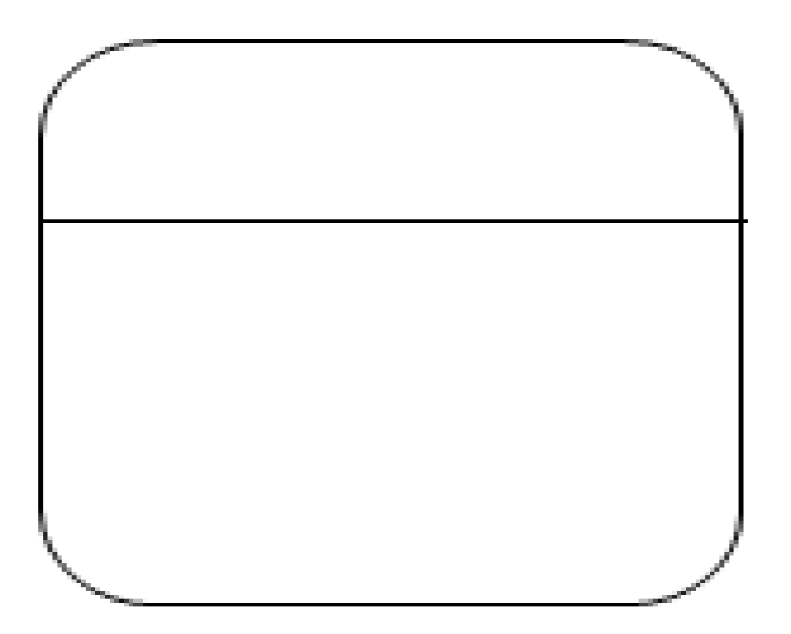
Symbols and Notations Used in DFD
Process
An activity that changes or transforms data flows. Since they transform incoming data to outgoing data, all processes must have inputs and outputs on a DFD.
Process
Process
Yourdon and Coad Notation
Gane and Sarson Notation
Data Flow
Movement of data between external entities, processes and data stores is represented with an arrow symbol, which indicates the direction of flow.

Slide 62
Rules for designing DFD
No process can have only output or only input. The process must have both input and output.

Slide 63
Rules for designing DFD
There should not be a direct flow between data stored and external entity. The flow should be go through a process.

Slide 64
Rules for designing DFD
No data should move directly between external entities. The data flow should go through a process.

Slide 65
DFD Level-0 (Context Diagram) For LMS
Assume all process of library.
Request for book
Member
Issue book
Library Management System
Request for generating report
Return book
Search book
Issue and return
book report generated
Result of searching book
Library Staff
Manage member account
Manage book database

Slide 66
Data flow diagram levels
Data flow diagrams are also categorized by level. Starting with the most basic, level 0, DFDs get increasingly complex as the level increases.
Level 0 DFDs, also known as context diagrams. It provides a basic overview of the whole system.
It shows the system as a single high-level process, with its relationship to external entities.
DFD Level 1 provides a more detailed breakout of pieces of the Context Level Diagram.
You will highlight the main functions carried out by the system, as you break down the high-level process of the Context Diagram into its sub processes.

Slide 67
DFD Level-1 For LMS
Book request
1.0
Issue book
Library card
Book
Book
Book Selves
Member
2.0
Return book
Book
Book
Search query
3.0
Search book
List of titles
Book request by name
title
author
Result by book name
List of author
Search query

Slide 68
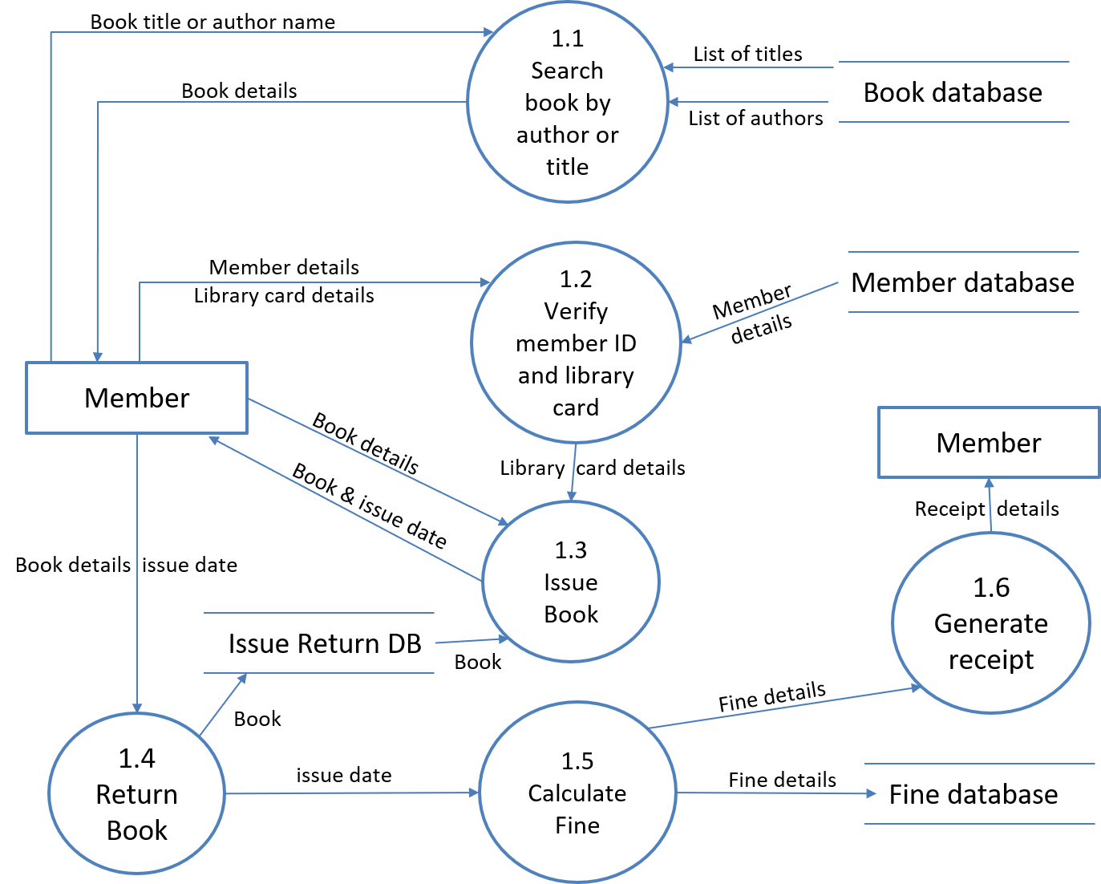
DFD Level-2 For LMS

Slide 69
Software Engineering (2304CS304)
Prof. Mayur Padia
Computer Engineering Department
mayur.padia@darshan.ac.in
+91-99255 15118

